Slide 1
Image processing(LPDR)
PRESENTED BY:- VAIBHAV KUMAR KAPRIYAL

Slide 2
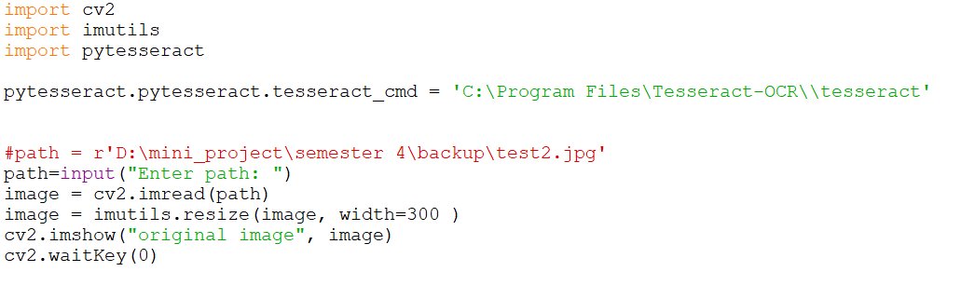
Used to perform different kind of operations on image
functional package to do image translation, rotation, resizing
OCR tool for python, used to recognize text form image
Used to load the tesseract software in the program
Open the image
Resize the image for processing
Show the image
Hold the image for infinite time

Slide 3
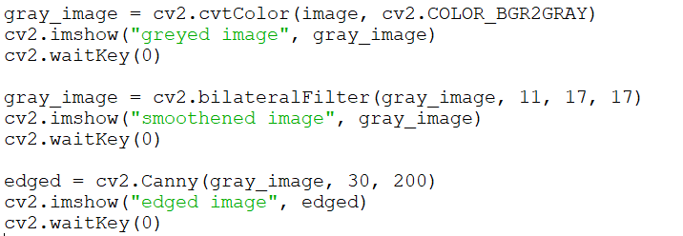
Convert image to grayscale
Smoothens the grayscale image
Shows the edges of the image
KNOWN AS THREASHOLD TECHNIQUE FOR CONVERTING IMAGE TO BINARY IMAGE

Slide 4
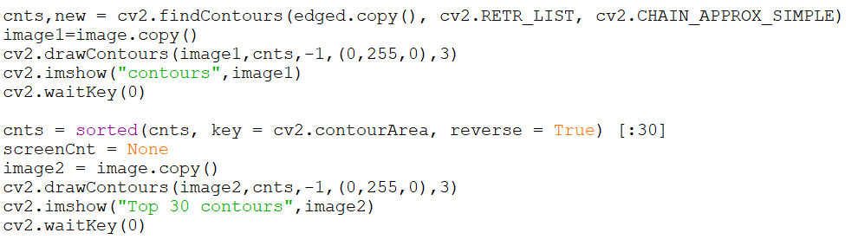
Find the contours from the edged image
Creates a copy of the original image
Draw the identified contours on the image
sorting contours based on the minimum area 30 and ignoring the ones below that
Stores the number plate contour
Shows the image after sorting

Slide 5
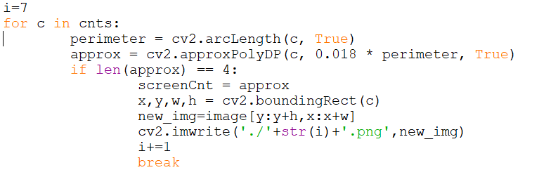
Loop in sorted contours
gives the length of the arch and checks if the shape is closed or not
It approximates a contour shape to another shape with less number of vertices depending upon the precision we specify.
This finds the coordinates of the part identified as the license plate
Stores the new image of the cropped number plate
chooses the contours with four sides as this will probably be our number plate

Slide 6
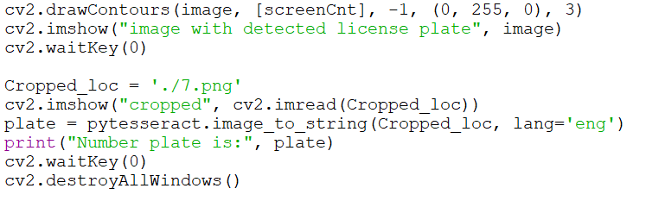
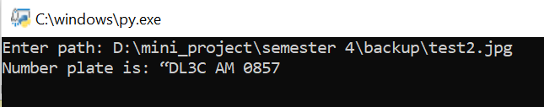
This draws the contour selected to be the number plate on our original image
Displaying the final image that has a contour drawn over the number plate
We are passing the image of the cropped part of the license plate. We are then calling on pytesseract to extract the text on the image

Slide 7
THANK YOU

